Slide 1

Finding the best inner London location for a new coffee shop
Applied Data Science Capstone by IBM/Coursera
Capstone Project

Slide 2
1. Introduction
My friend has a successful inner London coffee shop and has been approached by an investor keen to develop his cafe concept into a small franchise and expand across inner London.
Both he and the investor believe a key component of the cafe's success has been selecting a location close to a new high rise apartment development. By providing a friendly, buzzy cafe with great coffee he has created a communal place for the locals, who are typically young, professional renters with high disposable income and a taste for good quality coffee in the morning on their way to work, on weekends with a pastry, and increasingly during the day whilst they work from home during Covid lockdown.
He has asked me to help him identify other new high rise apartment developments that lack good coffee shops in the immediate vicinity, and will then propose these to the investor as potential sites to expand the coffee franchise.

Slide 3
2. Data
1. The London Development Database (LDD) which records significant planning permissions in London.
https://data.london.gov.uk/download/planning-permissions-on-the-london-development-database--ldd-/966b9309-3969-417e-b1d0-b97cfe42404a/LDD%20-%20Housing%20Completions%20unit%20level%20%28final%29.xlsx
2. A spreadsheet containing postcodes and latitude and longitude coordinates for the building developments in the final refined dataframe
'Geospatial_Coordinates.xlsx'
3. The FourSquare API which provides information on cafes.
'https://api.foursquare.com/v2/venues/explore?&client_id={}&client_secret={}&v={}&ll={},{}&radius={}&limit={}'.format(CLIENT_ID, CLIENT_SECRET, VERSION, neighbourhood_latitude, neighbourhood_longitude, radius, LIMIT)

Slide 4
3. Methodology
1. Identify the areas in London with the highest number of new flats and houses recently approved.
Target developments approved in the past 3 years
Restrict the data to include only inner London boroughs denoted by letters N, NE, NW, W, SW, S, SW, E and EC and followed by numbers 1-9. All postcodes with a number greater than 9 are outside the perimeter we're interested in.
Use 'Post Code' field for the location reference.
Use 'Total proposed units' and restrict the values to >6 to eliminate town house conversions.
Rename column field values so that they are more user friendly
Reformat date completed field to show only the year 'YYYY' to make it easier to select developments completed after 2017
Create a new dataframe with only the columns required
Remove duplicate rows to show only one row per development
Restrict dataframe to show developments only with >100 and <300 units completed after 2016
Remove incomplete post codes
Merge excel file with longitude and latitude for each post code using the post code field
Use Folium to create a map of London and plot the results on the map
2. Once we have identified some candidate sites, we will then identify the number of coffee shops in the local area, the mix of small independent cafes versus well known chains e.g. Costa, Pret, Starbucks, and the strength of the independent cafes ratings versus the chains. We will use the FourSquare API to complete this step.
3. Finally, we will then compare the most popular businesses in the vicinity of the candidate sites against the types of businesses in our current local vicinity to determine if the candidate site has clientele with similar tastes to our current site, and therefore might be more receptive to our product as is, or alternatively, might necessitate some tailoring to local tastes.

Slide 5
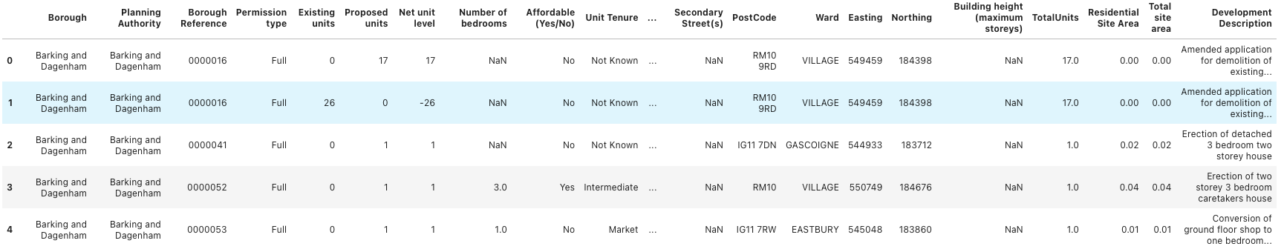
4. Results
The London Development Database from the Greater London Authority contained 149,856 records with the development description and proposed units revealing that there were many smaller developments that we didn’t want to look at

Slide 6
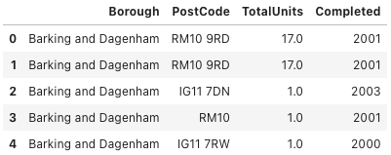
4. Results
The database has many fields that are not required for the analysis so I trim the dataframe to four columns

Slide 7
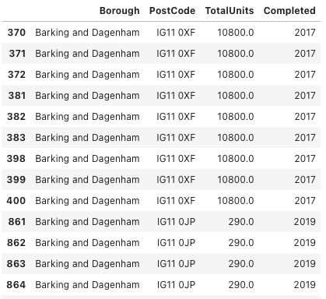
4. Results
There are many smaller developments that are not required for the analysis and also many developments that were completed a long time ago so I restrict the dataframe to show developments fitting the criteria of >100 & <300 units completed after 2016.

Slide 8
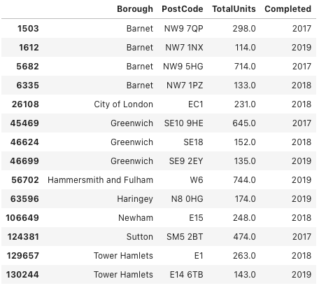
4. Results
Next I find a lot of duplicate rows which are likely amendments to the original planning permission.
I only want one record per development so we will cleanse the data using the drop-duplicates() function.

Slide 9
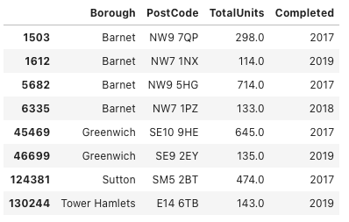
4. Results
We're also seeing a lot of post codes from outer London post codes, so we will restrict the dataframe to inner london postcodes only. Another problem identified is the lack of full post codes for some developments. This will make mapping the blocks impossible, so we will remove these. This is our final clean list of inner city developments.

Slide 10
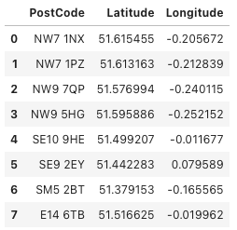
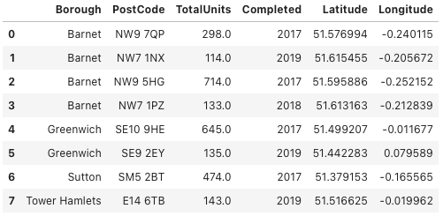
4. Results
We now need to import a dataframe containing latitude and longitude and then merge the two dataframes on the postcode field.
+
=

Slide 11
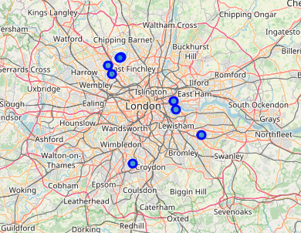
4. Results
I then use Folium to create a map of London using longitude and latitude coordinates and plot the developments on the map

